Slide 1


Slide 2



CONCEPTS
What is reverse brainstorming?
Notes:
Reverse brainstorming is a technique that flips typical brainstorming techniques upside down, allowing you to approach complex problems from a different perspective.
In traditional brainstorming, people will focus on collecting ideas for how to solve a problem. In reverse brainstorming, you instead look at what could make the problem worse or why the problem can’t be solved. Then, you reverse those ideas to discover new things you didn’t see before, allowing you to look at the problem, the cause and the solutions in a completely new way.

Slide 3
CONCEPTS
So when is a good time to use reverse brainstorming instead of traditional brainstorming?
When people have trouble coming up with good ideas quickly;
When people are stumped on how to solve a problem;
When you want people to let go of their pre-conceived ideas about a topic; or
When you want people to step out of their comfort zone and find new ways to problem-solve.
Notes:
Like in traditional brainstorming, the key to a successful reverse brainstorming session is quantity over quality. The more ideas you have, the more perspectives you have to work with when refining a solution.

Slide 4
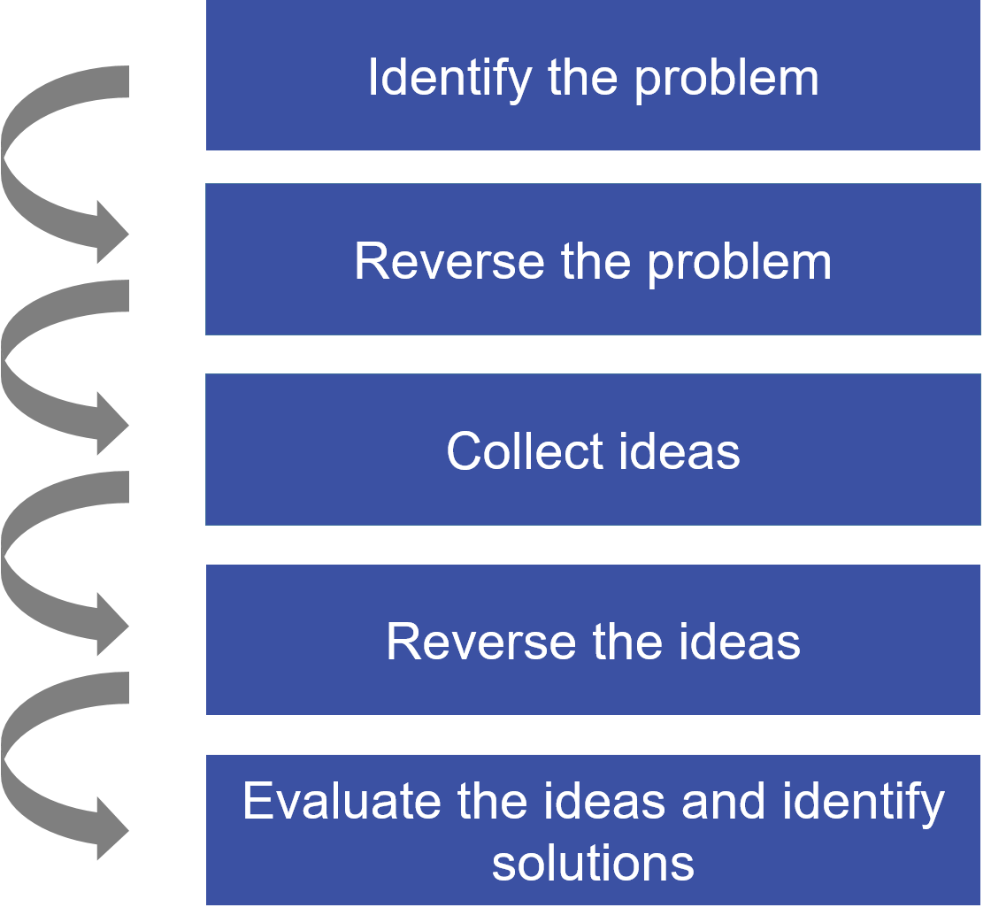
CONCEPTS
The reverse brainstorming process
Notes:
Like a traditional brainstorming session, reverse brainstorming typically starts with some sort of problem. Where it differs though, is that you then take that problem and reverse it to focus on the opposite of what you want to do.
From there, you and your team brainstorm ways to solve that reversed problem. Once you have a list of ideas, you then reverse those as well.
What you’re left with is a collection of ideas that can potentially be applied to your initial problem. Then it’s just a matter of analyzing and combing them to find the best solution.

Slide 5
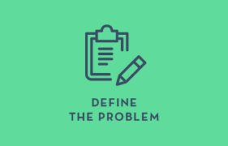
CONCEPTS
Step 1: Define your problem.
Notes:
Let’s take the lofty goal of improving team alignment during projects as an example. The problem to be solved would likely look something like this:
“We need to be better aligned as a team during projects.”

Slide 6
CONCEPTS
Step 2: Reverse the problem.
Notes:
Depending on the complexity of your projects and processes, you may find that fixing “team alignment” is a problem that is too tricky to solve through traditional brainstorming.
In such a case, a reverse brainstorming session may be just what the doctor ordered. Step 2 is to take your problem and flip it on its head. Here’s what your new problem would look like:

Slide 7

CONCEPTS
Step 3: Collect Ideas.
Notes:
Together, with your team, you can then start to brainstorm ways to ensure that you’re all completely misaligned for all projects going forward.

Slide 8
CONCEPTS
Some ideas that might come up could include:
Do not communicate project goals to the team.
Start working on the project without defining scope or desired results.
Start working before assigning roles.
Don’t share any files or research with the team.
Make key decisions without informing the rest of the team.
Constantly change the goals of the project.
Never, ever provide feedback or encouragement to the team.
Notes:
With a group of people in a room, you’ll likely be able to collect dozens of these “great” ideas to keep your team utterly misaligned for every project for eternity. And that’s great! The more of these you collect, the better the outcome will be.

Slide 9
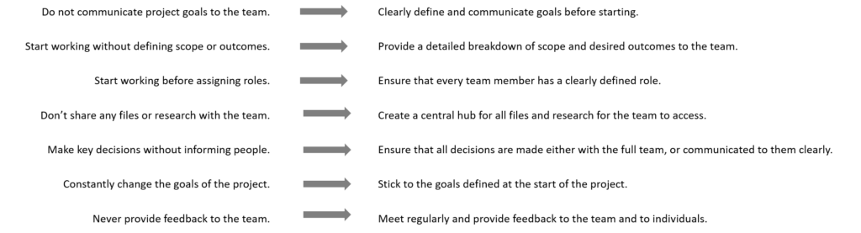
CONCEPTS
Step 4: Reverse the ideas.
Notes:
Once you’ve exhausted all those great ideas for team misalignment, work with your team to reverse each of them like you did with your initial problem.
In the case of the list in Step 3, this would look something like this:

Slide 10

CONCEPTS
Step 5: Evaluate the ideas and identify the solutions.
Notes:
Once you’ve gone through the exercise of reversing your bad ideas back into good ones, you can now analyze them to determine which are the best. With your team, go through each idea and prioritize them in whatever way you see fit. You’re now ready to take action and work on keeping your team aligned.
If you’re interested in learning techniques to improve team alignment during your projects, you may be interested in our free eBook titled 5 Ways to Drive (and Accelerate!) Project Team Alignment Using Mind Maps. Click here to download a copy!

Slide 11







/ethnuscodemithra
Ethnus Codemithra
/ethnus
/code_mithra
THANK YOU
https://learn.codemithra.com/
codemithra@ethnus.com
+91 7815 095 095
+91 9019 921 340

Slide 12
CONCEPTS

Slide 13
CONCEPTS

Slide 14
CONCEPTS

Slide 15
CONCEPTS

Slide 16
CONCEPTS

Slide 17
CONCEPTS

Slide 18
CONCEPTS

Slide 19
CONCEPTS

Slide 20
CONCEPTS

Slide 21
CONCEPTS

Slide 22
CONCEPTS

